Slide 1
Politische Wahrnehmungen in Zeiten der Krise
Theoretischer Hintergrund und Fragestellungen

Slide 2
Übersicht
0 – Logistik
1 – Theorie & Diskussion: Soziale Kohäsion in Krisenzeiten
2 – Methoden: Problem Set Besprechung
3 – Anwendung: Empirischer Überblick
Einblick in die eigene Forschung
Mit BUA Daten

Slide 3
0
Logistik

Slide 4
Anpassungen
Datacamp:
Mehr Einheiten Optional
Seminarplan wird angepasst , Datacamp nicht
Problem Sets
Abgabe nach Seminardatum
Gemeinsam Bearbeitung im Seminar
Wichtig: Videos vorher schauen für Anwendungsbeispiele
Kursablauf: 2x 90 Minuten + 5 Minuten Pause

Slide 5
1
Theorie & Diskussion

Slide 6
Übersicht: Theorie und Diskussion
Artikel 1: Zusammenhang Krisen und Demokratie(Wahrnehmungen)
Artikel 2: Wie messen wir sozial unerwünschte Verhaltensweisen?
Diskussion:
Einflussfaktoren und Zusammenhänge
Eigene Ideen

Slide 7
Artikel 1: Kriese und Demokratie
Kriesi, Hanspeter. “The Implications of the Euro Crisis for Democracy.” Journal of European Public Policy 25, no. 1 (January 2, 2018): 59–82. https://doi.org/10.1080/13501763.2017.1310277.
The question of whether European democracy is in crisis is not new, but is posed in a new way in the shadow of the euro crisis. In the tradition of the studies of democratic support and disaffection and based on data from the European Social Survey 2012, this article analyses the conceptions and evaluations of democracy in the different regions of Europe under the impact of the euro crisis. It shows that the perceived poor performance of the economy and of the government in the crisis, indeed, leads citizens across Europe to evaluate the way their national democracy works more critically – especially in the hard hit regions of Central and Eastern Europe and Southern Europe, and in authoritarian countries. However, it also shows that this critical evaluation of democracy does not undermine the citizens’ support for democracy. Quite to the contrary: democratic principles are actually strengthened by the dissatisfaction of the citizens with the economic and political performance of their countries in the crisis.

Slide 8
Fragestellung(en)
Welchen (unterschiedlichen) Einfluss haben Krisen auf Demokratiewahrnehmungen?
Welche Individualfaktoren erklären diesen Zusammenhang
Methoden: Logik der Quantitativen Analyse
Methoden: Abbildungen sind wichtig
Methoden: (Wie lesen wir SEM-Regressionsergebnisse)
Inhaltlich: Sozio-demographische Faktoren + Vertrauen als Erklärung
Inhaltlich: Unterschiede zwischen Regionen sind wichtig

Slide 9
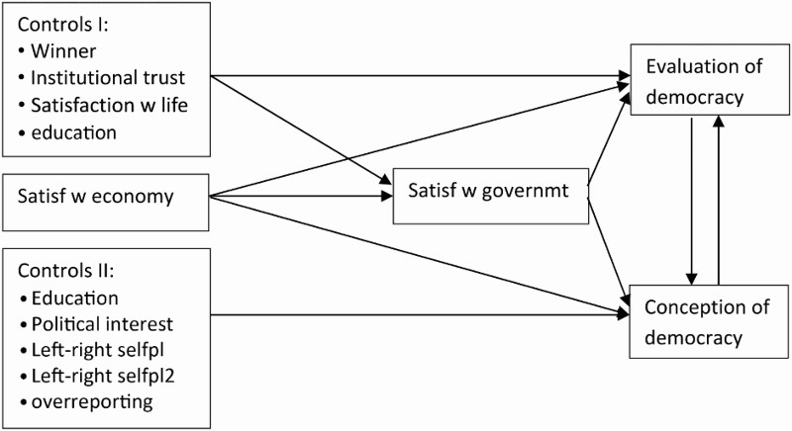
Model

Slide 10
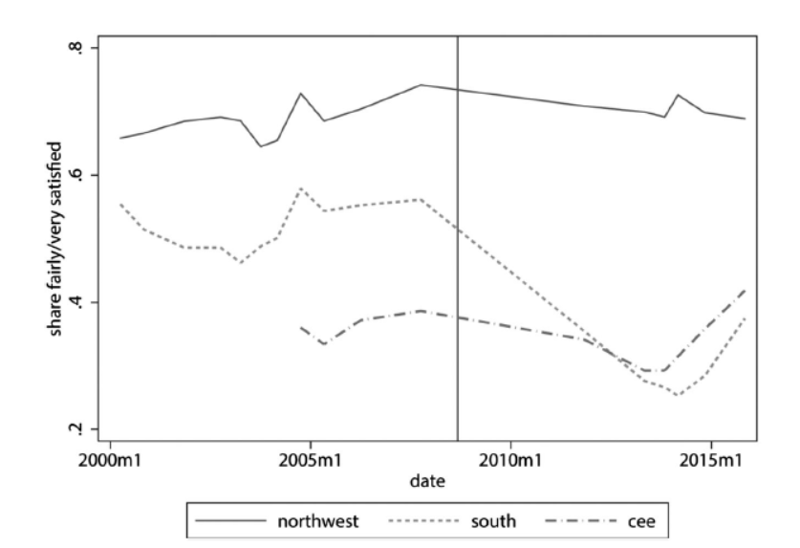
Einfache Ergebnisse

Slide 11
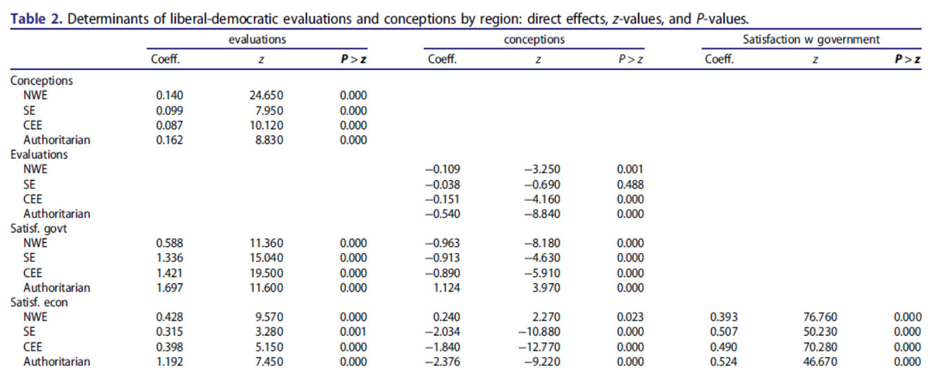
Komplizierte Ergebnisse

Slide 12
Artikel 2: Xenophobie
Krumpal, Ivar. “Estimating the Prevalence of Xenophobia and Anti-Semitism in Germany: A Comparison of Randomized Response and Direct Questioning.” Social Science Research 41, no. 6 (November 1, 2012): 1387–1403. https://doi.org/10.1016/j.ssresearch.2012.05.015.
An experimental CATI-survey (N = 2041), asking sensitive questions about xenophobia and anti-Semitism in Germany, was conducted to compare the randomized response technique (RRT) and the direct questioning technique. Unlike the vast majority of RRT surveys measuring the prevalence of socially undesirable behaviors, only few studies have explored the effectiveness of the RRT with respect to the disclosure of socially undesirable opinions. Results suggest that the RRT is an effective method eliciting more socially undesirable opinions and yielding more valid prevalence estimates of xenophobia and anti-Semitism than direct questioning (‘more-is-better’ assumption). Furthermore, the results indicate that with increasing topic sensitivity, the benefits of using the RRT also increase. Finally, adapted logistic regression analyses show that several covariates such as education and generalized trust are related to the likelihood of being prejudiced towards foreigners and Jews.

Slide 13
Fragestellung(en)
Wie messen wir sozial unerwünschte Verhaltensweisen? (Xenophobie)
Welche Faktoren erklären Xenophobie
Take-Away Punkte
Methoden: Logik der Quantitativen Analyse
Methoden: Wie lesen wir logistische Regressionsergebnisse
Methoden: Messung von „schwierigen“ Fragen
Inhaltlich: Sozio-demographische Faktoren + Vertrauen als Erklärung
Inhaltlich: Manche Menschen haben keine Probleme, rassistische Aussagen zu treffen

Slide 14
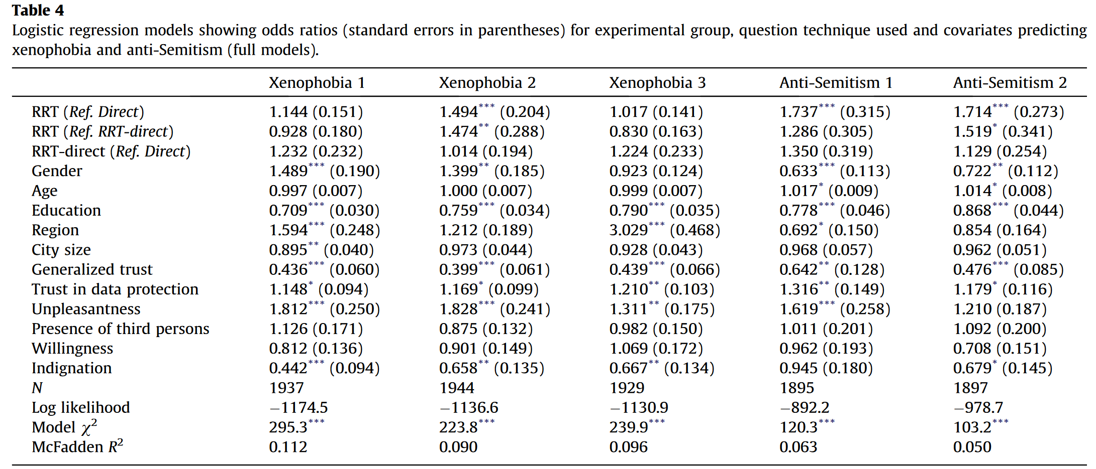
Ergebnisse

Slide 15
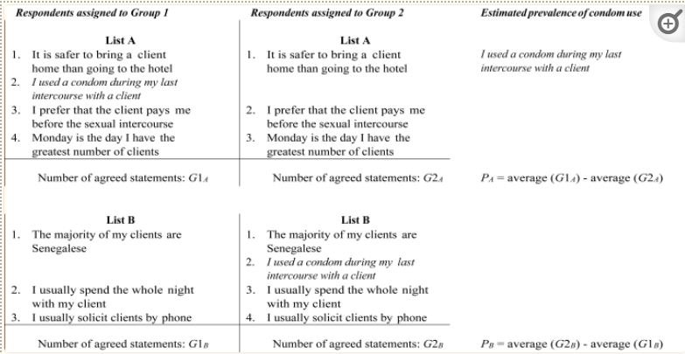
Alt.Techniken: Listenexperimente 1
Erstelle eine Liste von „unproblematischen“ Statements
Definiere das „problematische“ Statement
Teile Probanden in zwei zufällige Gruppen
Gruppe 1: Kontroll-Liste
Gruppe 2: Volle Liste
Berechne relativen Unterschied in der Anzahl an Zustimmungen

Slide 16
Alt.Techniken: Listenexperimente 2
Redlawsk, David, Caroline Tolbert, and William Franko. “Voters, Emotions, and Race in 2008: Obama as the First Black President.” Political Research Quarterly 63 (December 1, 2010): 875–89. https://doi.org/10.1177/1065912910373554
Some people will vote for Barack Obama this fall and some people will not. Regardless of your overall feelings toward him, please indicate how many of the following five facts about Obama trouble you when you think about choosing the next president. I SHOULD ADD, TOO, THAT we are not interested in WHICH ONES trouble you, only HOW MANY. Are you ready?“
During the primary campaign, he described small-town Pennsylvanians as bitter and said that they cling to guns and religion.
He has served in the US Senate only since 2005.
3 He used to be a smoker.
4 He was a member of Jeremiah Wrights Trinity United Church of Christ for 20 years, before he resigned in May of 2008.
The treatment group received the above baseline with a fifth item: 5. If elected, he will be the first black president.

Slide 17
Alt.Techniken: Listenexperimente 3
F5: Die Corona Pandemie hat das Verhalten vieler Menschen verändert. Wir wollen Sie nun fragen, WIE VIELE dieser Dinge Sie in Ihrem eigenen Leben verändert haben. Sie müssen uns nicht sagen, welche Dinge sich genau verändert haben, nur WIE VIELE
Seit dem Beginn der Pandemie
(A)… trage ich eine Maske beim Einkaufen und in öffentlichen Verkehrsmitteln
(B)...arbeite ich mehr im Home-Office
(C)… treffe ich Freunde und Bekannte weniger häufig
(D)… versuche ich mindestens 1.5 Meter Abstand von anderen Menschen einzuhalten
(E)… machen mich größere Ansammlungen von Menschen nervös
(F)… gehe ich Asiaten lieber aus dem Weg.

Slide 18
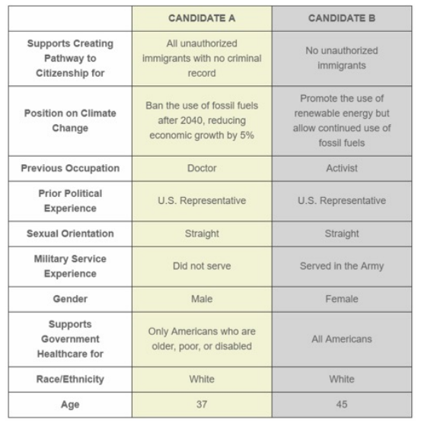
Alt.Techniken: Conjoint Exp. I
Definiere Liste von Charakteristika von Interesse
Gib Proband*Innen die Wahl zwischen zwei Möglichkeiten, mit variierenden Charakteristika
Möglichkeit der Berechnung: Individueller Einfluss der Characteristika

Slide 19
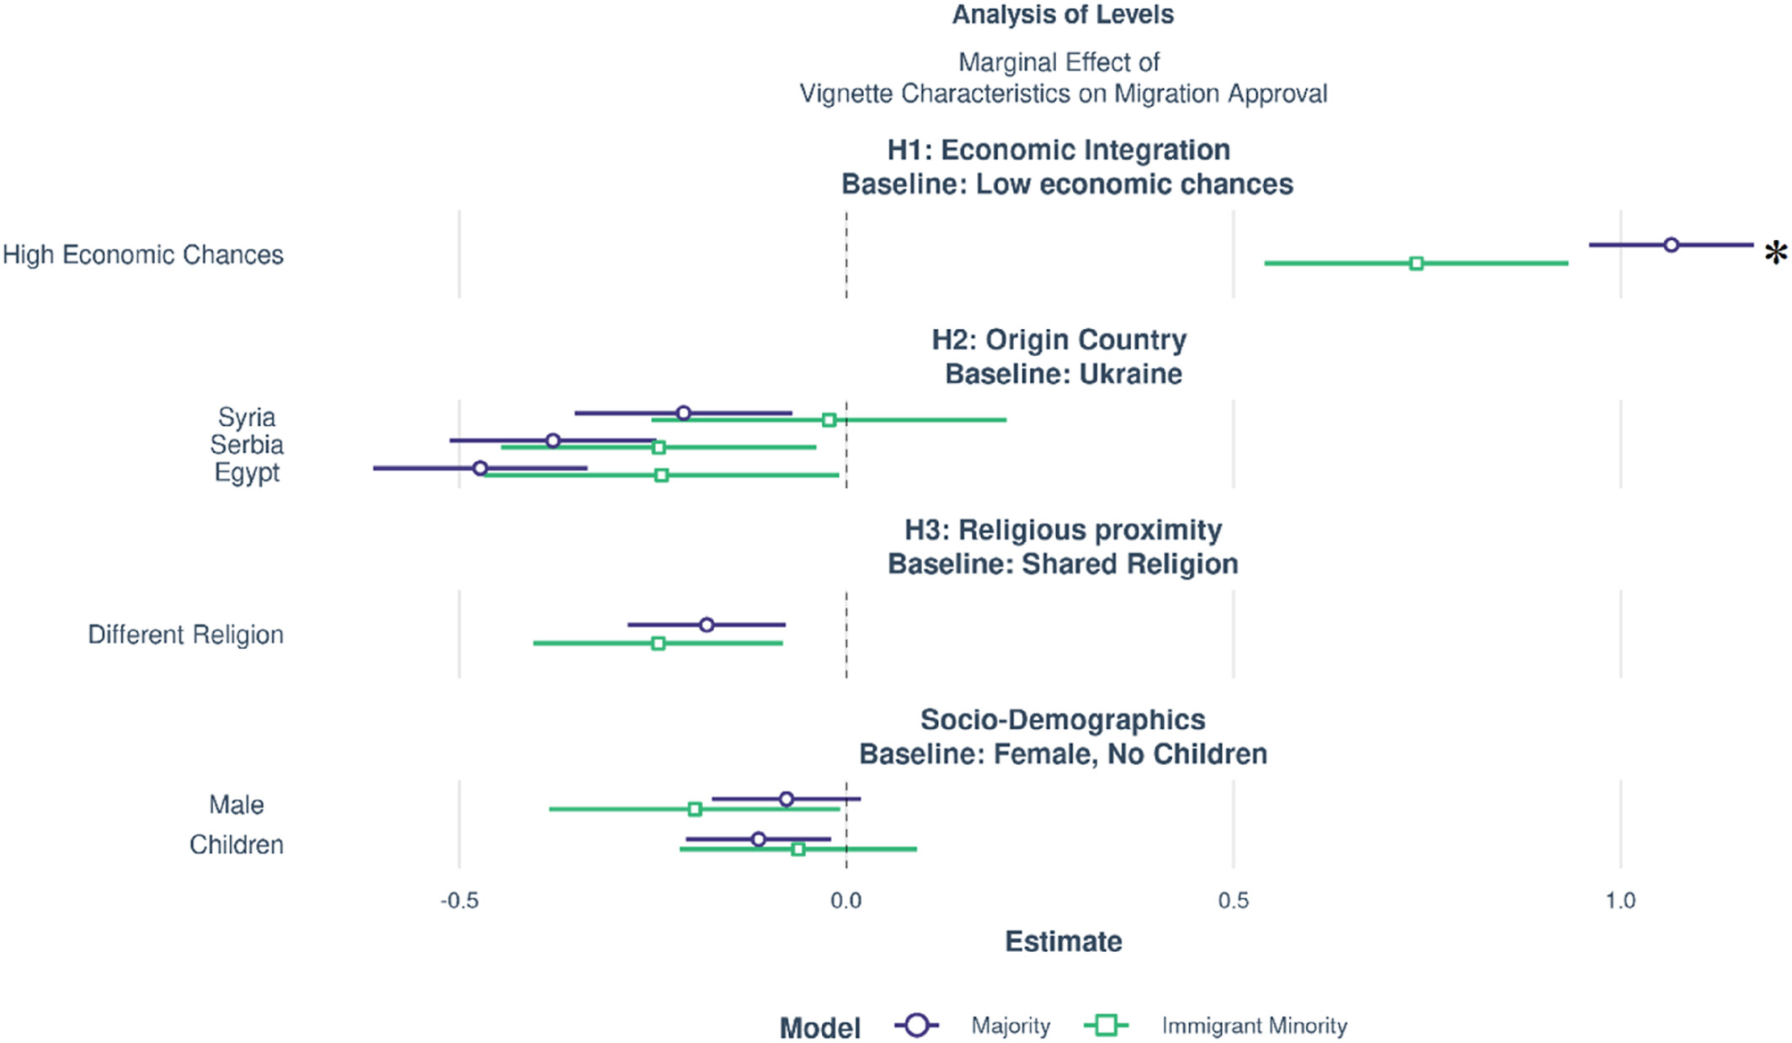
Alt.Techniken: Conjoint Exp. III
Mayer, Sabrina J., Christoph G. Nguyen, Jörg Dollmann, and Susanne Veit. “The Hidden Majority/Minority Consensus: Minorities Show Similar Preference Patterns of Immigrant Support as the Majority Population.” The British Journal of Sociology n/a, no. n/a. Accessed May 20, 2023. https://doi.org/10.1111/1468-4446.13013.
Now we show you some profiles of people that want to come to Germany and like to know your opinion about that. Person 1 is a [man/woman] and wants to migrate from [Ukraine/Syria/Serbia/Egypt] to Germany. [He/She] is 40 years old. [[He/She] will be able to find quickly a job in Germany due to their qualifications. / Due to their lack of qualifications, [he/she] will have problems finding work straight away.] [He/She] has two minor accompanying children. [He/She] will migrate alone.] [He/She] is [Muslim/Christian/nonreligious].
After reading the vignette, respondents had to indicate whether this person should get unlimited right of residence in Germany. The scale ranged from 1 “totally disagree” to 6 “totally agree”.

Slide 20
2
Problem Set Besprechung

Slide 21
Besprechung des Problemsets
Code auf Blackboard
Fragen?

Slide 22
3
Eigene Datenarbeit

Slide 23
BUA Daten- Rassismus Skalen
Modern Racism Scale Index (1 to 5, α =0.86) :
How much would you disagree/agree with the following statements:
Discrimination of members of ethnic and religious minorities is no longer a problem in Germany
Ethnic and religious minorities make too many demands for equal rights
Members of ethnic & religious minorities should not interfere without being asked
In the last few years, ethnic and religious minorities in Germany have profited economically more than they deserve
In the last few years, government and media have Shown more respect to ethnic and religious minorities than they deserve
It is easy to understand the anger of ethnic and religious minorities (RC)
Preferred Social Distance (-3 to 3) How unpleasant/ pleasant if a
German without migrant background (α = 0.96)
an Asian person (α = 0.94)
a Black Person (α = 0.93)
a Muslim (α = 0.92)
your neighbor
your colleague
Marries into your family
becomes

Slide 24

Eigene Forschung: Ekel

Slide 25
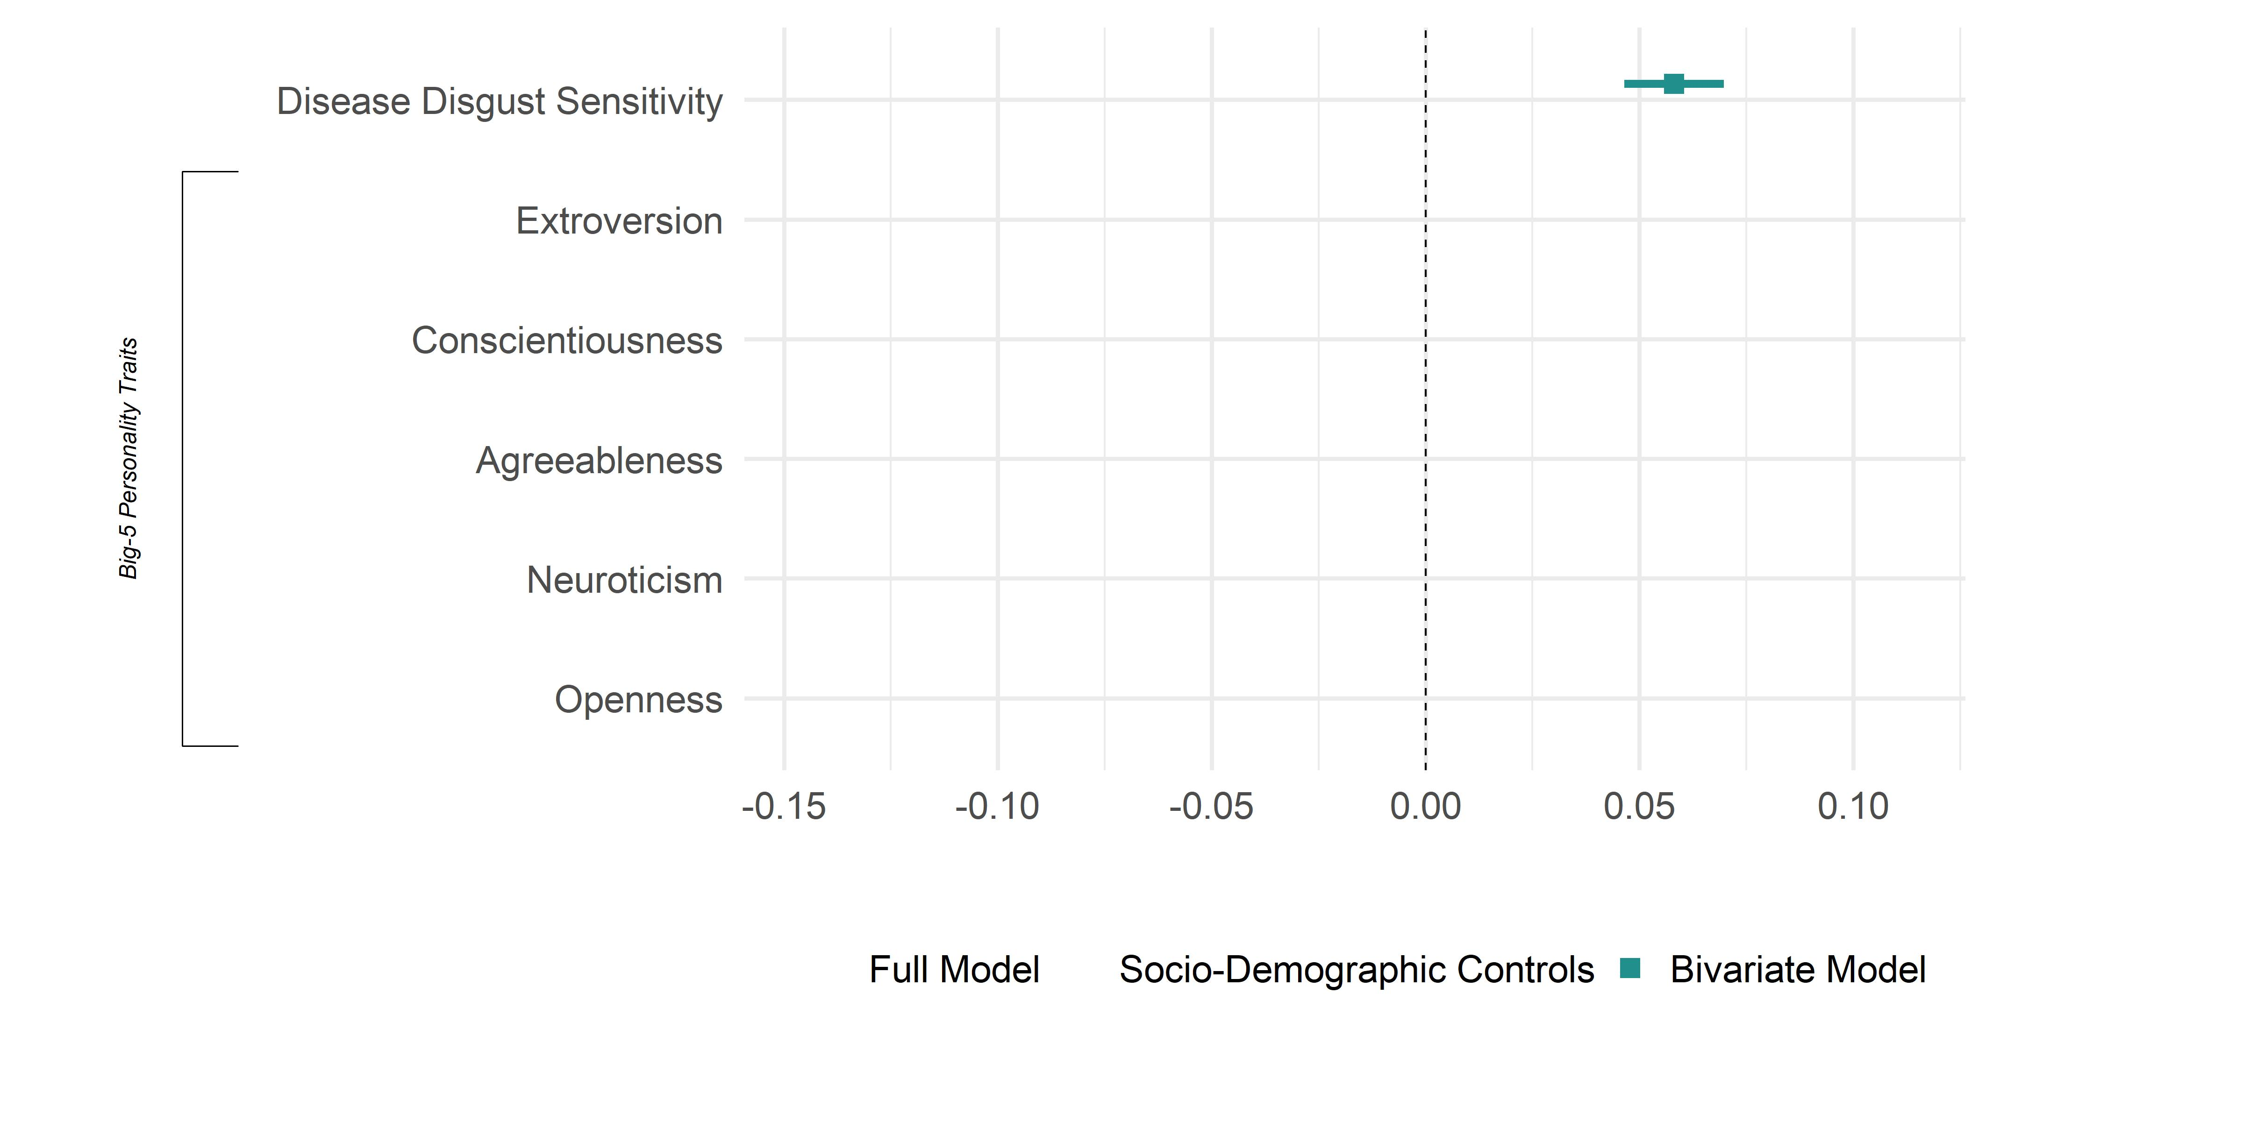
Bivariate Model: Modern Racism

Slide 26
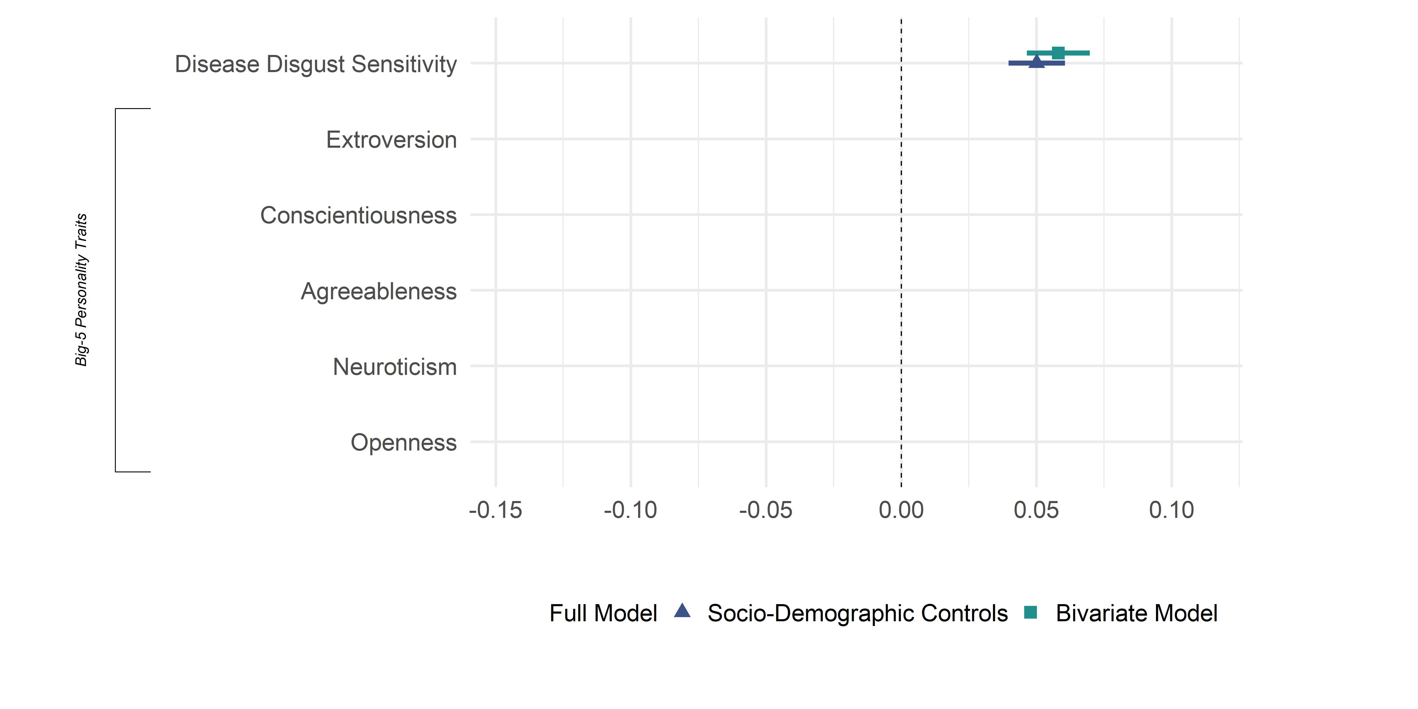
Soc-Dem Model: Modern Racism
Includes Controls for Age, Gender, Left-Right Self placement, Education, Main Activity & Bundesland

Slide 27
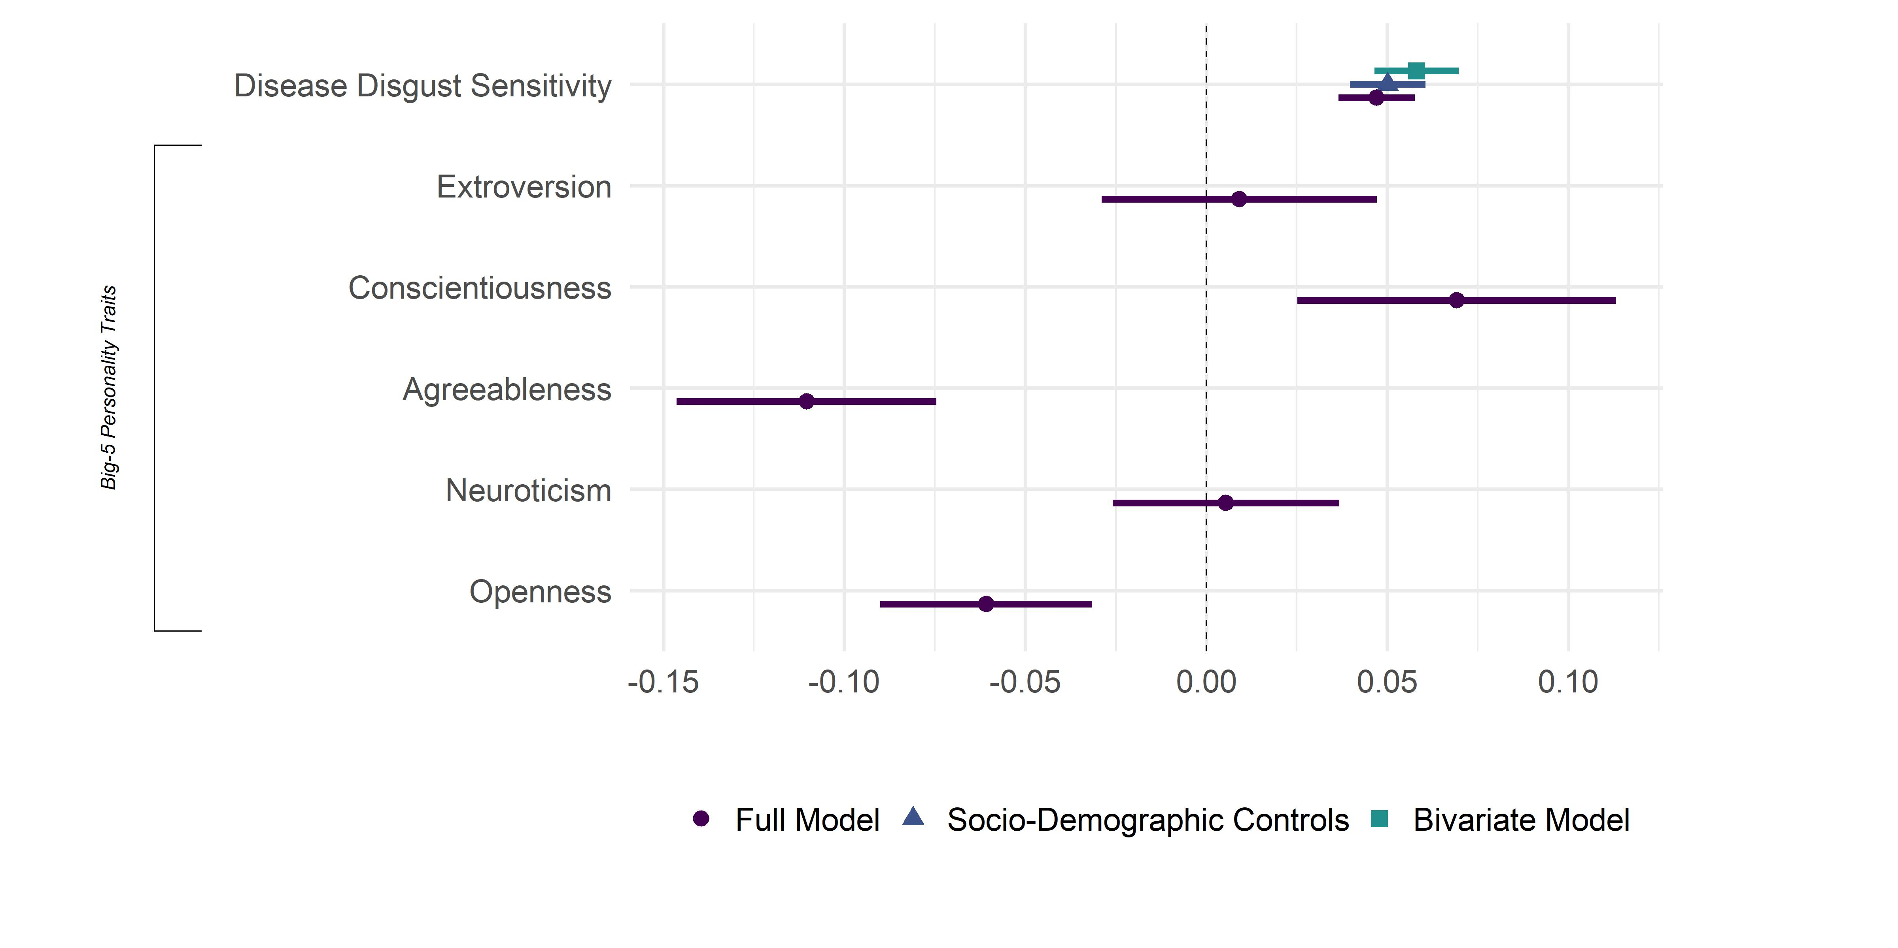
Full Model: Modern Racism
Includes Controls for Age, Gender, Left-Right Self placement, Education, Main Activity & Bundesland

Slide 28
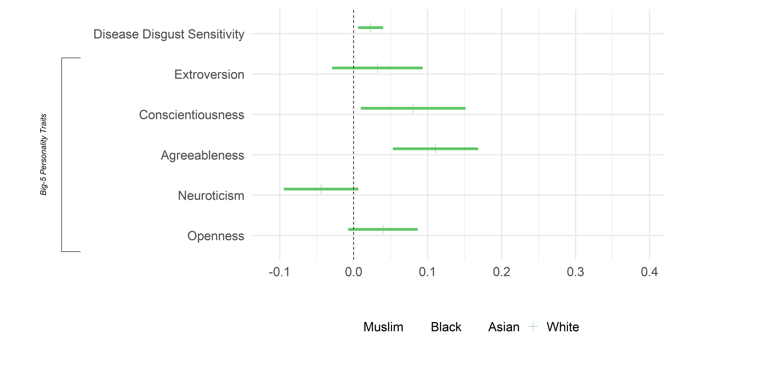
Results: Distance/ Avoidance
Includes Controls for Age, Gender, Left-Right Self placement, Education, Main Activity & Bundesland

Slide 29
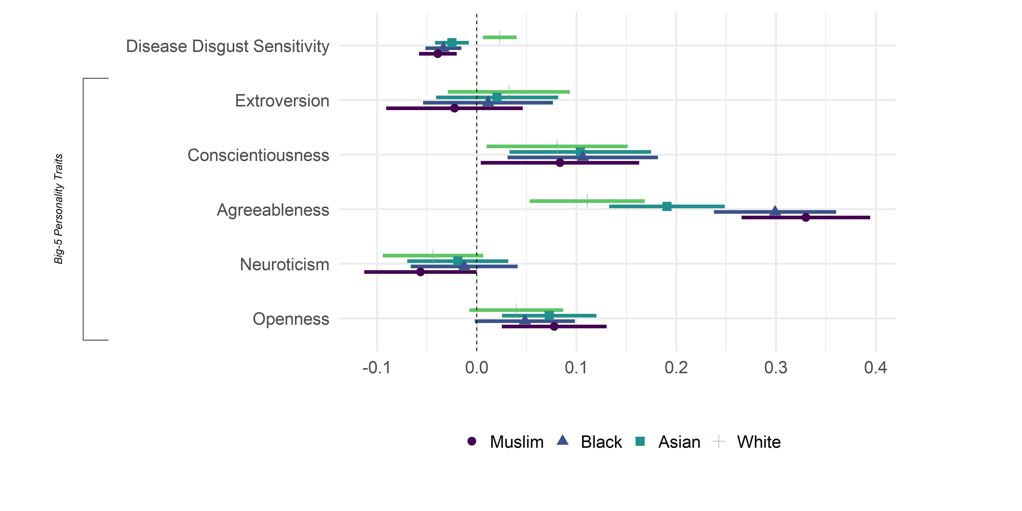
Results: Distance/ Avoidance
Includes Controls for Age, Gender, Left-Right Self placement, Education, Main Activity & Bundesland

Slide 30
Alt.Techniken: Conjoint Exp. III
Auswahl muss nicht in Textformat passieren
Beispiel: BUA Projekt Studie zum Verhalten im öffentlichen Raum
10 “Trials”
Charakteristika
Ethnische Identität : White, Asian, Muslim / MENA, Black
Geschlecht: Mänlich vs. Weiblich
Masken: Mask or No mask
Andere Variablen Controls ( Left vs. right seat & Trial Order )

Slide 31
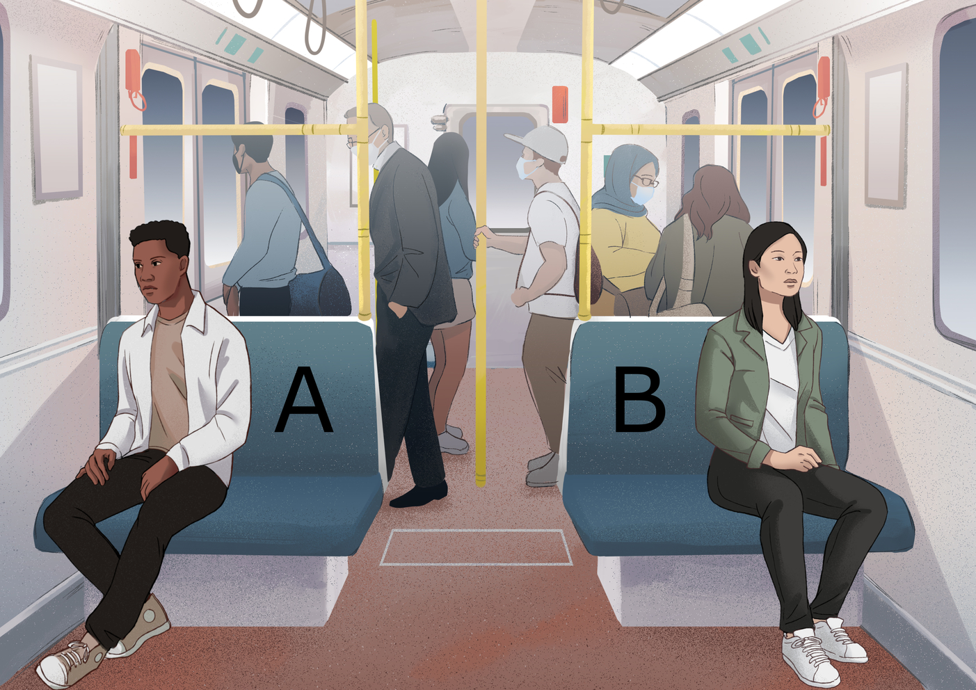
Examples

Slide 32
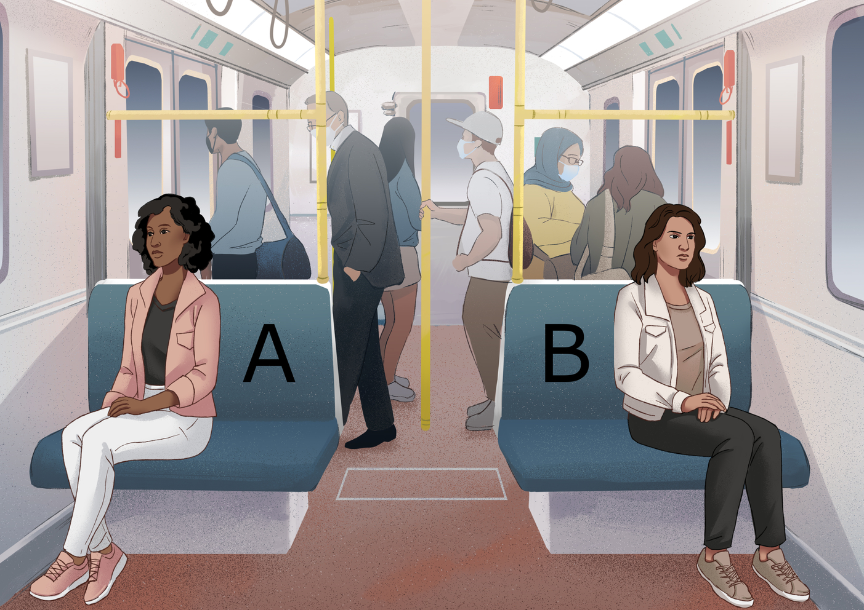
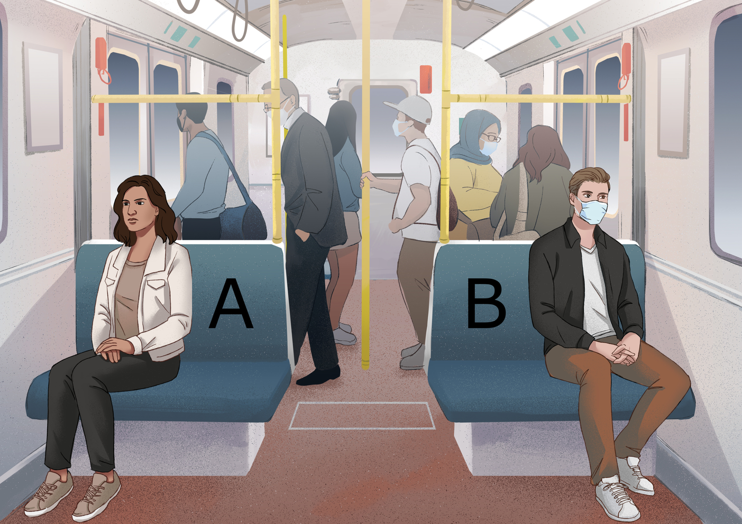
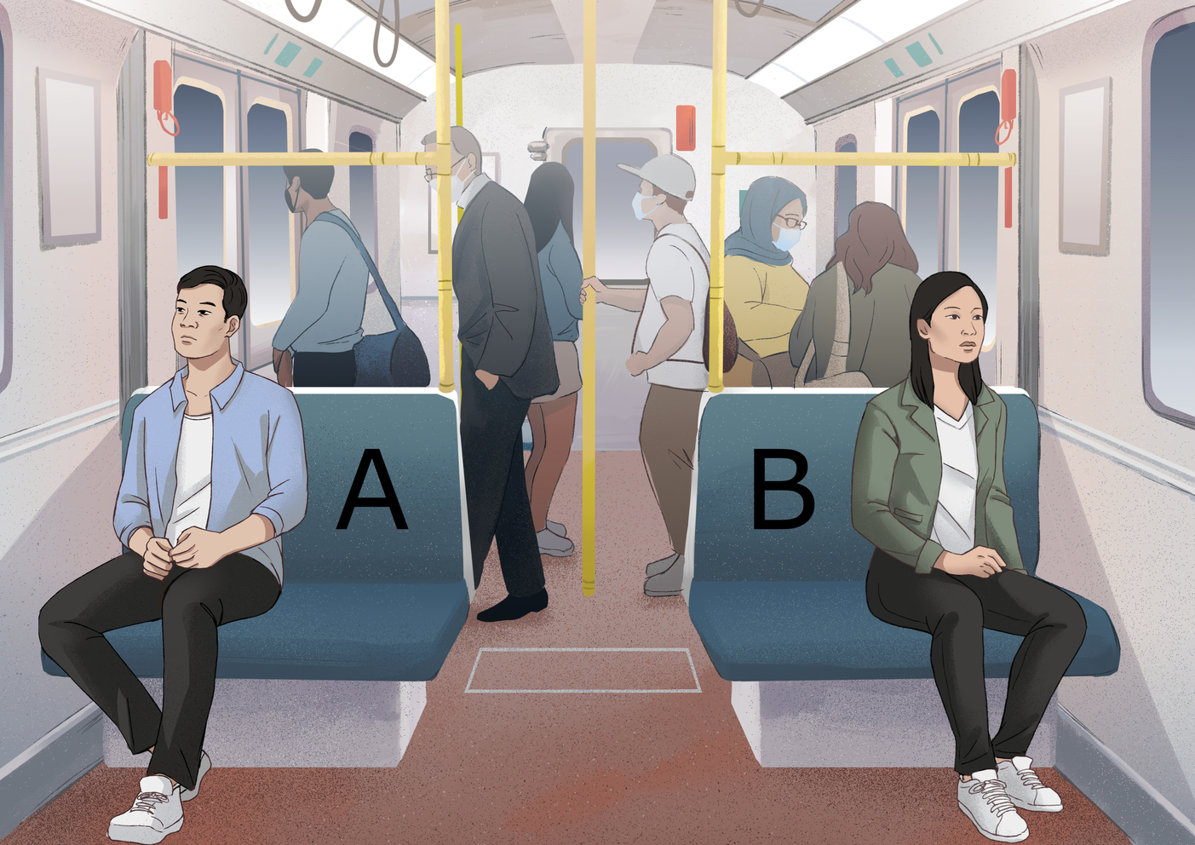
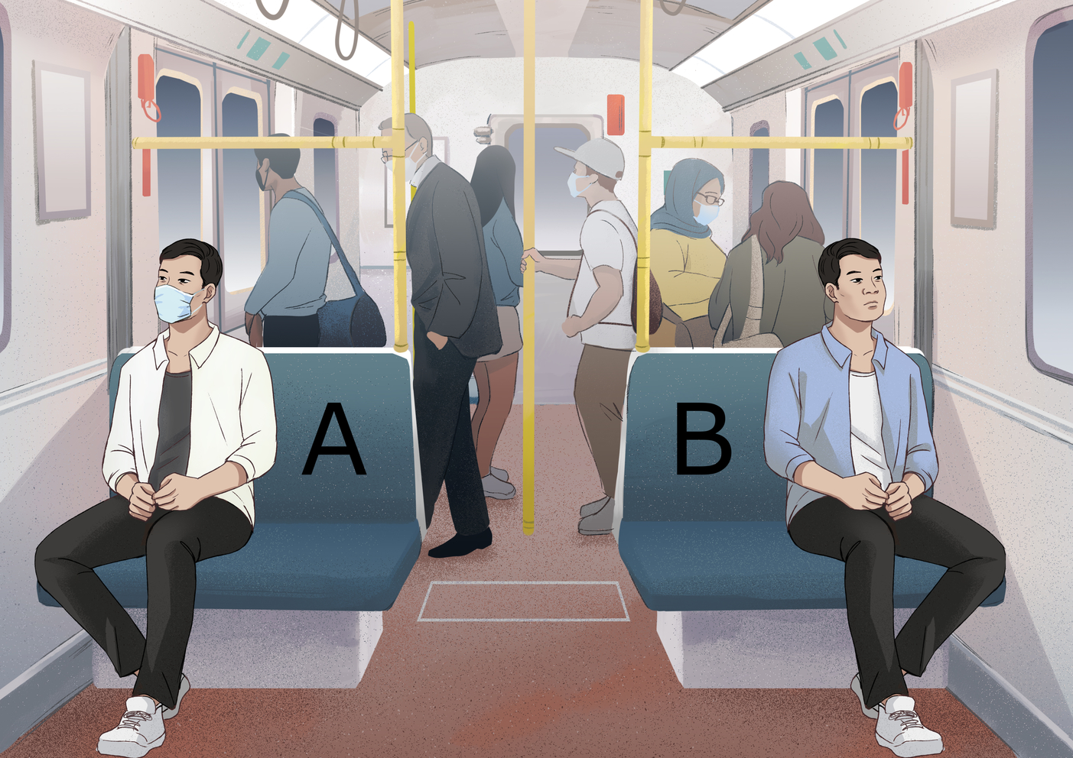

Slide 33
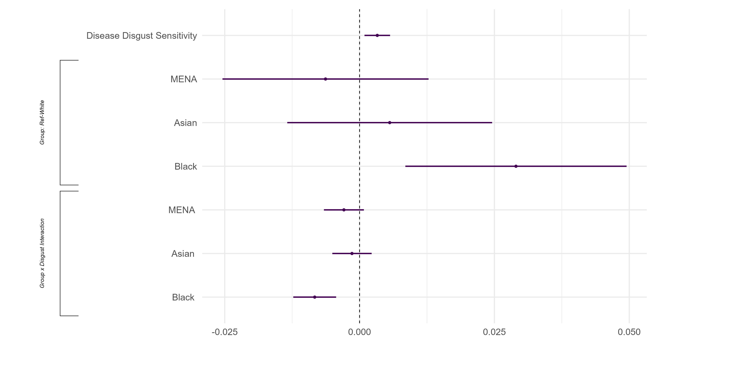
Results: Marginal Effects

Slide 34
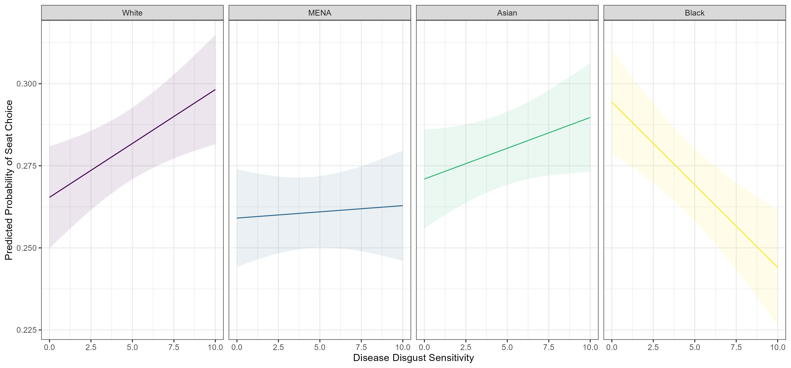
Resultate: Wahrscheinlichkeit

Slide 35
Eigene Analyse: BUA Daten
Variablen Identifizieren (siehe Fragebogen Welle 1)
Identifiziert 1-2 Abhängige Variablen
Identifiziert 1-4 unabhängige Variablen
Daten Vorbereiten
Daten Herunterlande und in R öffnen
Bereinigt die Daten (Code auf Blackboard)
Beschreibt die Verteilung/ Zusammenhänge zwischen euren Variablen
Visualisierungen
Theorie
Vorstellung

